Slide 1

Northeastern University - Seattle
CS6650 Building Scalable Distributed Systems
Professor Ian Gorton

Slide 2

Building Scalable Distributed Systems
Assignment 1 Overview

Slide 3

Building the Client…

Slide 4



Overall Aim
latency
Multithreaded client
Cloud server
Learning Objectives:
Write a complex multithreaded Java program
Implement a simple HTTP API
Configure and deploy a cloud based server
Implement a simple Java servlet
Learn how to analyze application performance

Slide 5
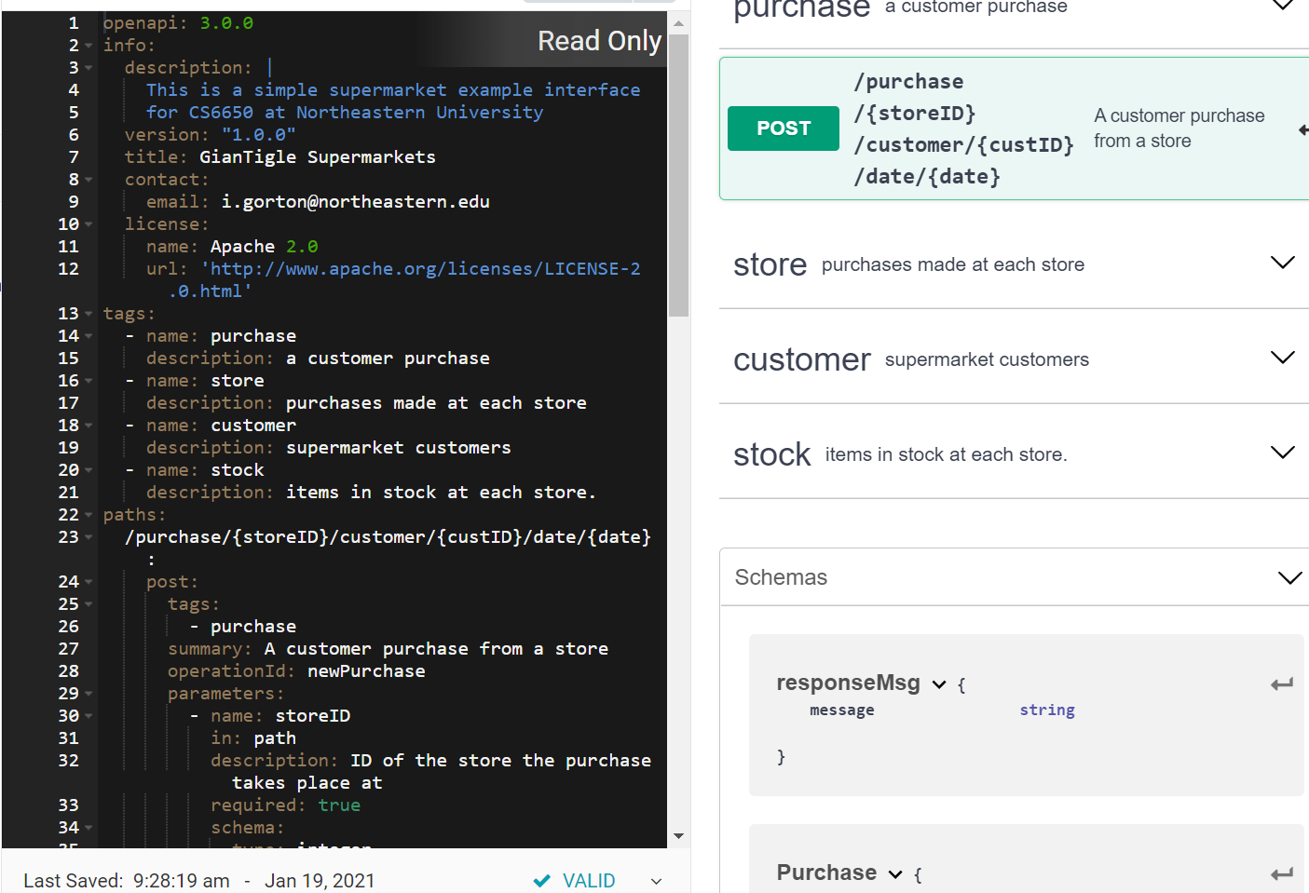
Step 1 – Build the Server
API specified in Swagger
Server implemented as a Java servlet running in Tomcat
Each API
Validates inputs
Returns a valid response
That’s it ☺
Test APIs with Postman

Slide 6
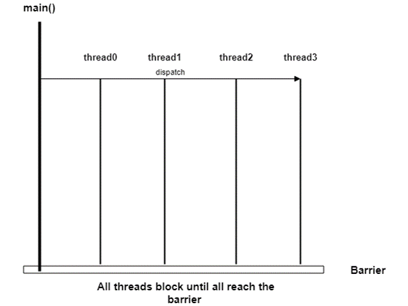
Step 2 – Build the Client (Simple)
Build a multithreaded Java client to measure server performance
3 phases to warmup and cooldown server
Max 256 threads
Write-heavy workload specified in assignment
Test with 32, 64, 128, 256 threads
Measure total ‘wall time’ performance and throughput for a test

Slide 7
Stage 2 Results
Server effectively does nothing
Client threads send requests and do nothing
Therefore you should get the highest possible throughput ☺☺☺
Things to consider:
Execute client and server as close together as possible
Same data center?
Laptop -> data center distance minimized
Throughput is requests/second

Slide 8

Stage 3 – Instrument Client
We want to measure and record the latency for every request
We can use this to get insights into how the system is performing
Every request latency needs to be stored for post-processing to calculate:
Mean, median, p99, throughput
Want to achieve this with as little overhead as possible
Eg compare throughput with 32 threads from Stage 2 to instrumented version in Stage 3.
The difference is the code you have added - the instrumentation
Should be small (<5%)

Slide 9

Things to Consider in Stage 3
Client has limited heap space
You are capturing 1000s of latencies – this has to be fast
Thread local operations are fast
Avoid unnecessary serialization
Collections.sort() – scalable?
Many charting options:
http://www.jfree.org/jfreechart/

Slide 10
Summary
There’s lots of cloud/tomcat infrastructure to get working
Easy once you know how
Look critically at your results – we will ;)
Good luck!!

